Slide 1
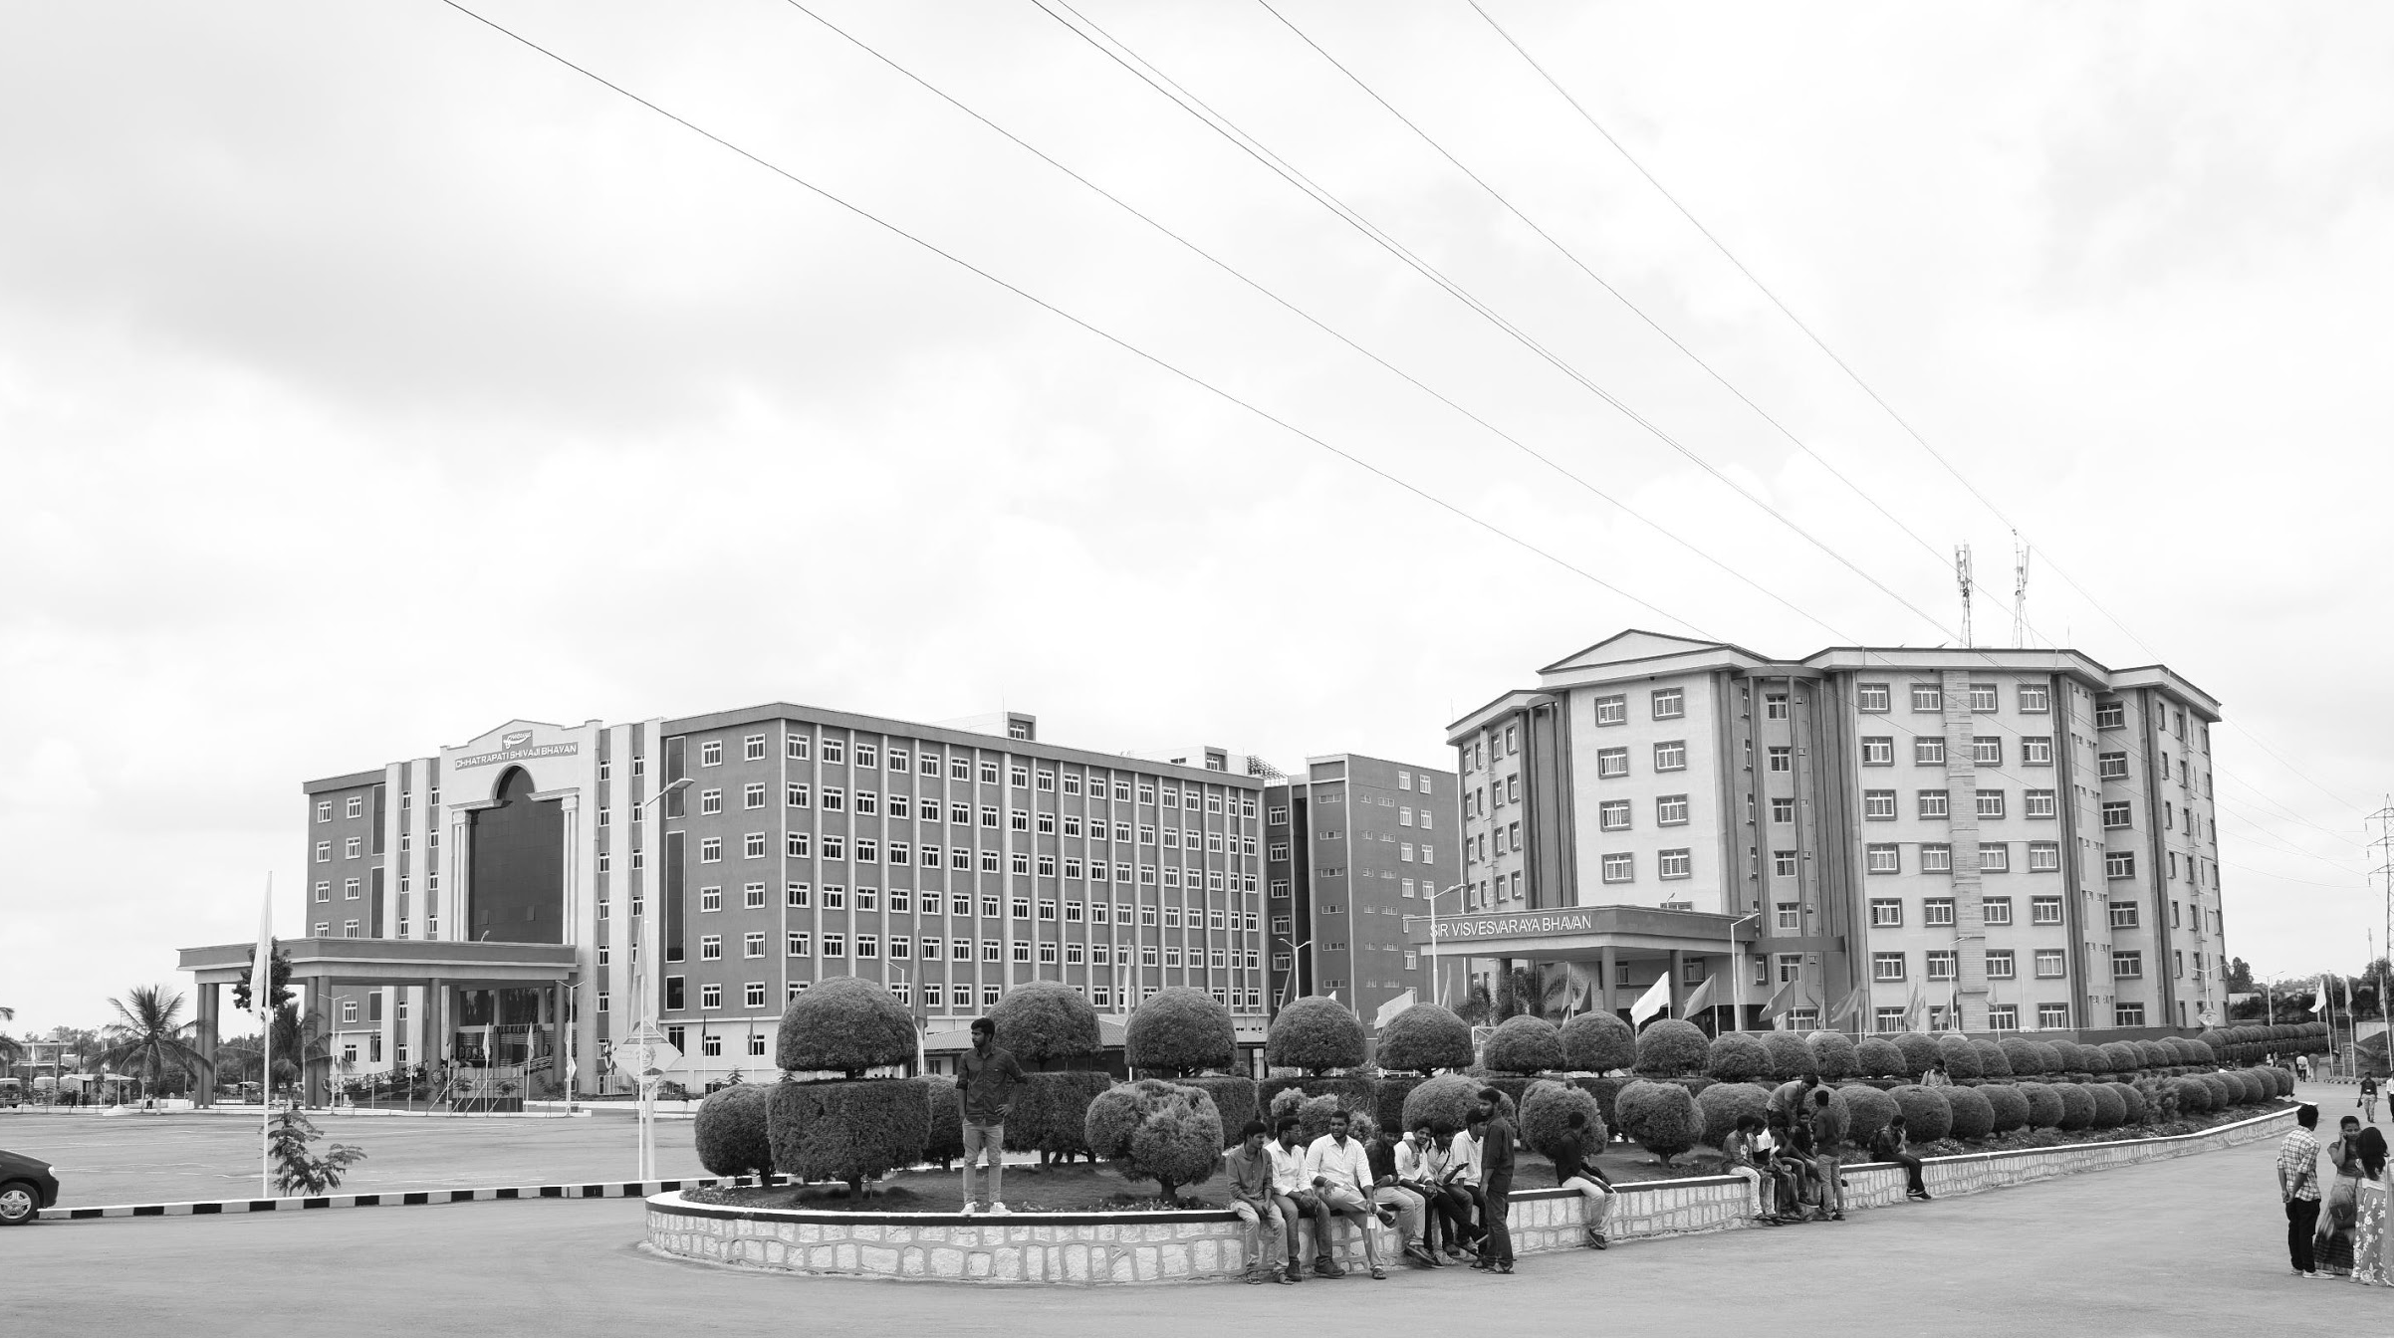

Implementation of an SDR-based GNSS Receiver for GPS Location
AY 2021-2025
GITAM UNIVERSITY
Minor Project
Project ID: XX
A University should be a place of light, of liberty, and of learning.
Department of Electrical Electronics and Communication Engineering
Project Team:
> Khateeb Gousiya
(BU21EECE0100467)
> Sana Sowmya
(BU21EECE0100398)
> Mavilla Akash (BU21EECE0100206)
Project Mentor:
Dr. Nagarjuna Telagam
Asst. Professor
Department of EECE
www.gitamedu.com

Slide 2




Project Group – Details
Photo
Track
Roll No
Name
Photo
EECE AI/ML
BU21EECE0100467
Khateeb Gousiya
Photo
EECE AI/ML
BU21EECE0100398
Sana Sowmya
Photo
EECE (REG)
BU21EECE0100206
Mavilla Akash

Slide 3

Objective and Goals
Objective
->To Develop an Software Defined Radio-Based GNSS receiver using USRP N321 and to acquire and process signal from multiple GNSS (Global Navigation Satellite System) constellation in real-time.
Goals
Main Goals
1. Design GNSS receiver blocks in GNU radio
2. Integration with USRP N321 Hardware
3. Acquire real time signal from satellites

Slide 4
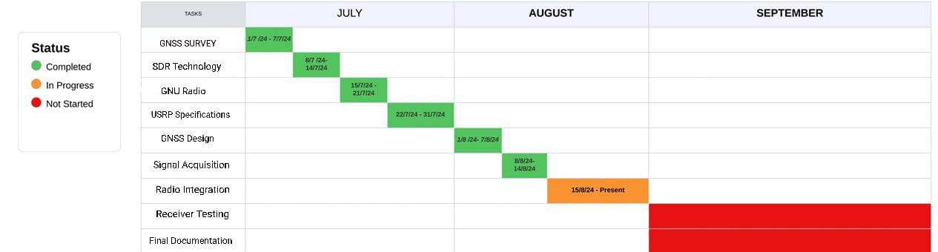
Project Plan
Gant Chart - Milestones and Activities
Resources : https://www.officetimeline.com/gantt-chart/how-to-make/excel & https://www.teamgantt.com/

Slide 5
Literature Survey
Key Publications
Kaplan, E. D., & Hegarty, C. (Eds.). (2017). Understanding GPS/GNSS: principles and applications. Artech house.
Pany, Thomas, et al. "GNSS Software-Defined Radio: History, Current Developments, and Standardization Efforts." NAVIGATION: Journal of the Institute of Navigation 71.1 (2024).
Samigulin, Shamil Nailevich. "Efficient GNSS Signal Acquisition Method for GNSS/GNSS-R Software-Defined Receivers." (2023).
Existing Implementations – Products| Opensource| GitHub etc
https://github.com/gnss-sdr/gnss-sdr
https://github.com/taroz/GNSS-SDRLIB
https://github.com/yimingc/gnss_sdr
https://www.gnuradio.org/
https://www.ettus.com/all-products/usrp-n321/

Slide 6
Analysis - SWOT
Strengths
Weaknesses
W1. Complexity
W2. High Learning Curve
W3. Cost
W4. Latency
S1. Flexibility in Signal Processing
S2. Real-Time Processing Capabilities
S3. Open-Source Software Support
Threats
T1. Competition from Dedicated GNSS Hardware
T2. Vulnerability to RF Interference and Spoofing
Opportunities
O1. Multi-Constellation GNSS Support
02. Advanced Research and Innovation
O3. Custom Applications
04. Integration with Other Technologies

Slide 7
Analysis – 4W1H
Why: To develop a flexible, cost-effective GNSS receiver that enhances GPS tracking accuracy using software-defined radio (SDR) technology.
What: A GNSS receiver built on SDR principles using the USRP N321 to track and process GPS signals from satellites.
Where: Implementation and testing will occur in controlled lab environments and field locations with open sky visibility.
When: The project timeline includes design, development, and testing phases, targeting completion within the next 12 to 18 months.
How: By leveraging the USRP N321 platform, implementing algorithms for signal acquisition and tracking, and refining these through iterative testing.
Refined Objective: To create a robust, scalable SDR-based GNSS receiver that improves GPS accuracy and reliability for various applications.

Slide 8
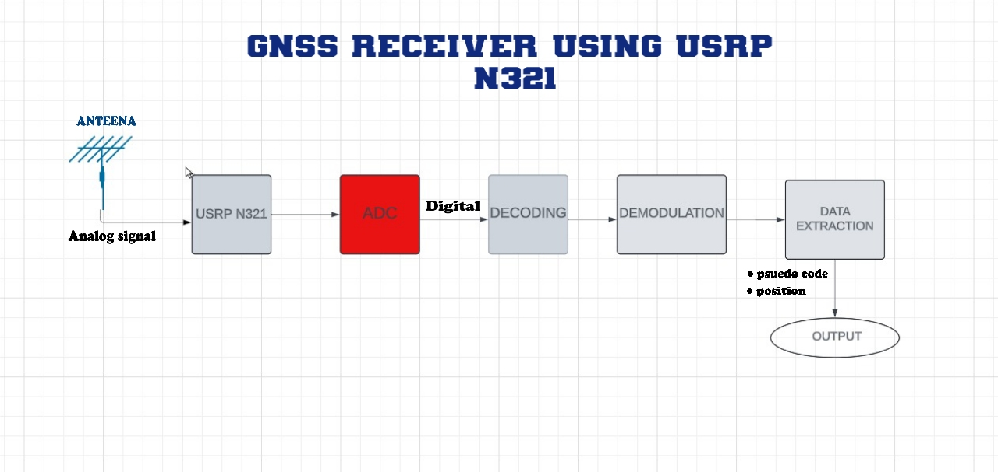
Architecture
Structural Diagram
Block Diagram/Pin Diagram
Resource - https://lucid.app/lucidchart/65653f16-657a-45d1-8d73-a02bc5807bbd/edit?viewport_loc=-2152%2C-247%2C3072%2C1250%2C0_0&invitationId=inv_ffe0bbc8-ec4e-4720-a051-d2abff8714c4

Slide 9
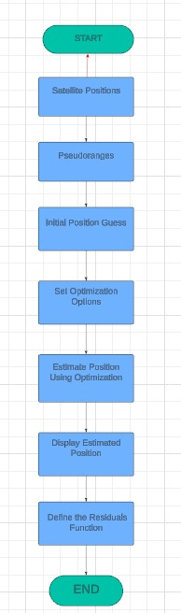
Architecture
Behaviour Diagram
Flow chart/ State machine
Resource -https://lucid.app/lucidchart/cbee06f2-15e7-4980-936e-b21a14a0fb1b/edit?invitationId=inv_35971db5-788b-49d1-bbba-cd99ba916f7c

Slide 10
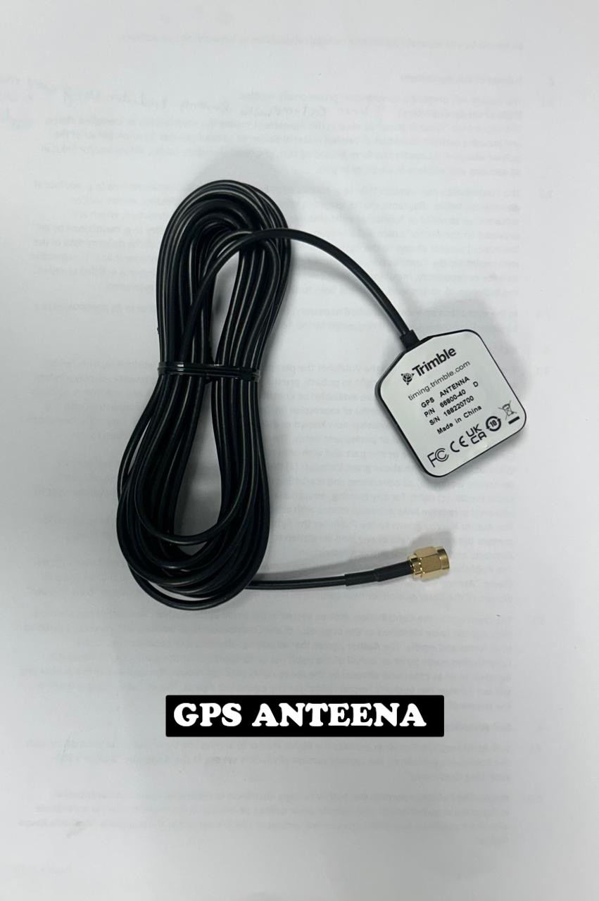
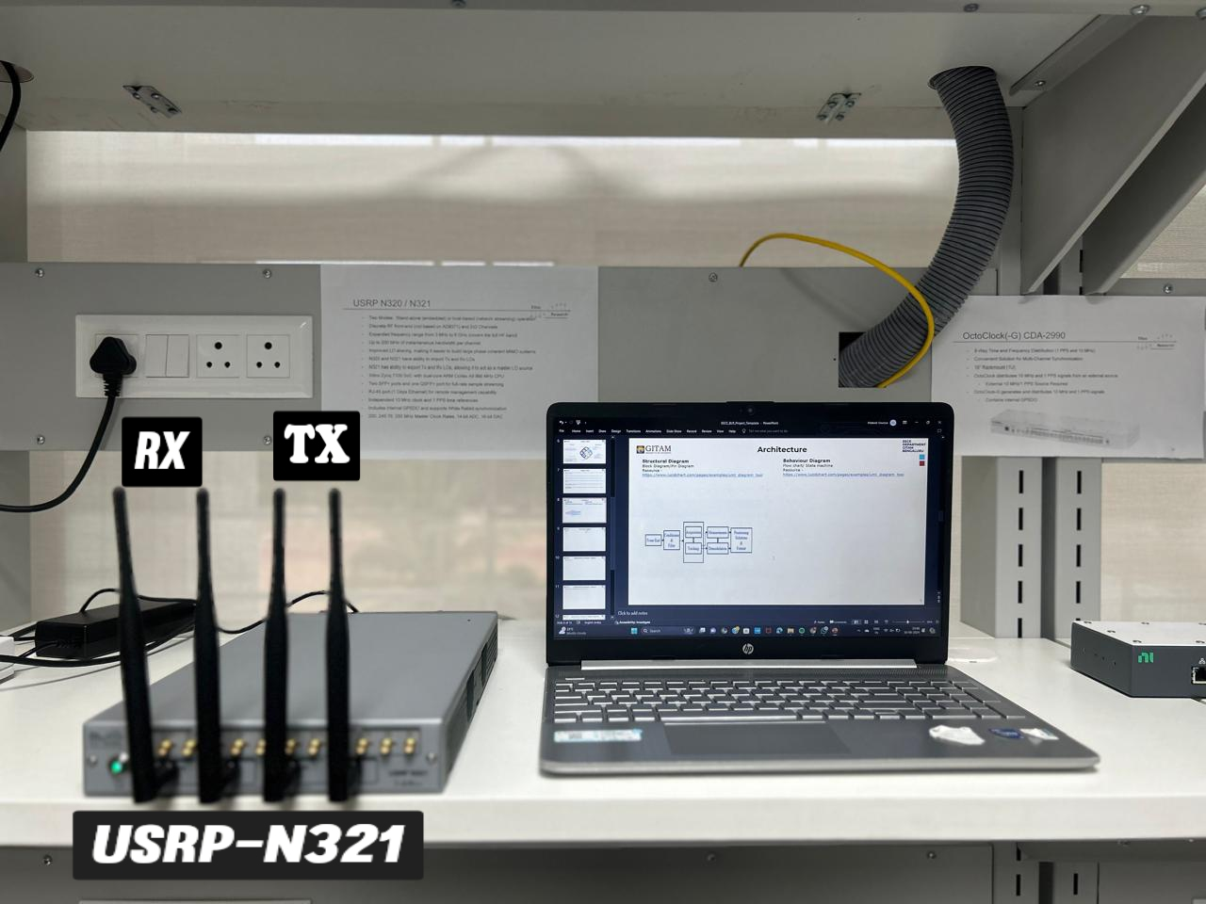
Demonstration Setup
> P/N : 66800-40 >RX : Receiver
>S/N : 188220700 >TX : Transmit

Slide 11
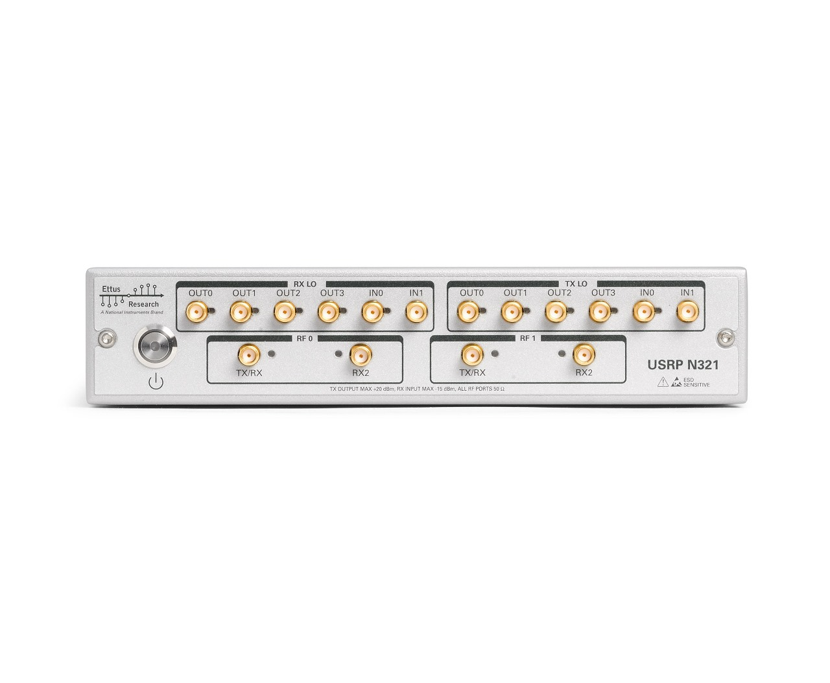
USRP N321
Multiple I/O Ports: The USRP N321 is equipped with a variety of input and output ports, including TX/RX and RX-only ports, which allow for flexible signal transmission and reception across multiple channels.
High-Performance RF Capabilities: The device supports a wide range of RF frequencies and bandwidths, making it suitable for various applications in communication systems, including research and development.
Modular Design: The modular layout of the USRP N321 allows for easy integration and scalability, providing adaptability for different experimental setups and requirements.
Additional Note: This device will be utilized in further projects, where its advanced features will be crucial for implementing and testing new communication technologies.

Slide 12
Use Cases & Testing
Use Cases
Precise Positioning:
Used in surveying, agriculture, and construction for high-accuracy GPS with RTK.
Navigation in Challenging Environments:
Optimized for weak signal areas like urban canyons or indoors.
Resilience Against Spoofing/Jamming:
Advanced techniques to mitigate GPS spoofing and jamming attacks.
Test Cases
Signal Acquisition and Tracking Test: Verify the receiver’s ability to acquire and continuously track GPS satellite signals in various signal conditions.
Position Accuracy Test: Measure the accuracy of the calculated GPS position under different environmental conditions, including open skies and urban canyons.
Multipath Error Test: Evaluate how well the receiver mitigates multipath errors in environments with reflective surfaces, like buildings or water.
Doppler Shift Handling Test: Test the receiver’s ability to handle Doppler shifts caused by relative motion between the GPS satellites and the receiver.

Slide 13
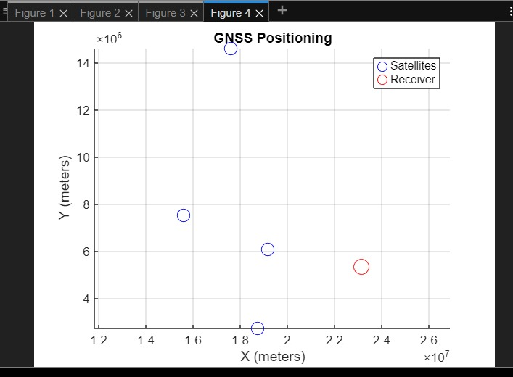
Implementation and Results
This graph provides a 2D representation of GNSS (Global Navigation Satellite System) positioning, showing the relative positions of satellites and a receiver. Here's a brief explanation:
Blue Circles (Satellites): The blue circles represent the positions of the GNSS satellites in the X-Y plane, with their coordinates measured in meters. These are the satellites involved in positioning the receiver.
Red Circle (Receiver): The red circle shows the estimated position of the receiver (e.g., a GPS device) in the X-Y plane, calculated based on signals received from the satellites.

Slide 14
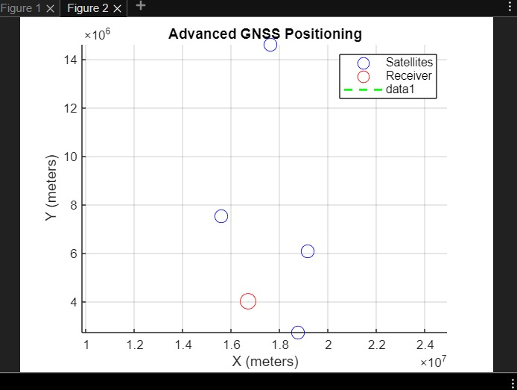
Implementation and Results
This 2D graph, titled "Advanced GNSS Positioning," shows the satellite and receiver positions in an X-Y plane. Here are two key points:
Positions of Satellites and Receiver: The blue circles represent the positions of satellites, and the red circle marks the position of the receiver. The X-axis (in meters) ranges from approximately 1.0 to 2.4 × 10710^7107, while the Y-axis (in meters) ranges from 0 to 14 × 10610^6106. The satellites are scattered across the plane, and the receiver is positioned at X ≈ 1.8 × 10710^7107, Y ≈ 4 × 10610^6106.
GNSS Visualization: This graph simplifies the spatial relationship between the satellites and receiver into two dimensions, where the distances and positions are analyzed for GNSS-related positioning purposes.

Slide 15
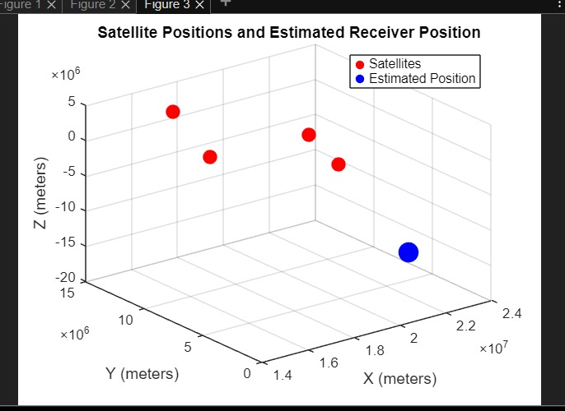
Implementation and Results
This graph represents satellite positions and an estimated receiver position in 3D space. Here's a brief explanation:
Red Dots (Satellites): The red dots indicate the positions of multiple satellites in space, with their respective coordinates along the X, Y, and Z axes measured in meters.
Blue Dot (Estimated Position): The blue dot shows the estimated position of the receiver (likely a GPS receiver), which is determined based on the satellite signals, also plotted in the X, Y, and Z coordinates.

Slide 16
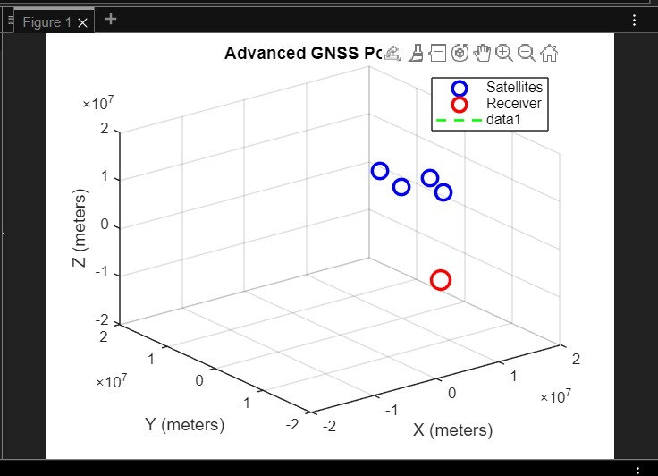
Implementation and Results
This graph represents the positions of satellites and a receiver in a 3D coordinate system in meters (X, Y, Z axes). Here are three key points:
Satellite and Receiver Positions: The blue circles represent the satellites, while the red circle marks the receiver. The coordinates of both are shown in a 3D space, typically used in GNSS (Global Navigation Satellite System) applications.
Spatial Relationships: The satellites and receiver are positioned in different locations in space.
The receiver is slightly isolated compared to the grouping of satellites, indicating it is calculating its position based on the satellite data.

Slide 17
Contribution
Team Progress and Movement
MATLAB Simulation: Developed and tested MATLAB codes for accurate distance calculations, improving real-time location tracking.
Algorithm Optimization: Enhanced signal processing algorithms for better precision in GPS coordinate determination.
SDR Integration: Initiated integration of MATLAB simulations with the Software Defined Radio (SDR) for effective communication between software and hardware.
Data Collection: Conducted tests with collected GPS signals to validate distance calculations and system functionality.
Team Collaboration: Promoted effective teamwork, sharing insights and troubleshooting challenges during development.
Individual Contribution
Key contributions by K. Gousiya :
Developed and tested MATLAB codes focused on distance calculation algorithms, contributing to the precision of the GNSS receiver.
Assisted in data analysis and validation of distance outputs against expected GPS values.
Key contributions by M. Akash:
Collaborated in optimizing the signal processing algorithms in MATLAB to improve overall accuracy and efficiency of the receiver.
Took the lead in integrating MATLAB outputs with the SDR hardware for effective signal transmission and reception.
Key contributions by Sana Sowmya:
Conducted initial tests using real GPS signals and analyzed the performance of the receiver, ensuring the robustness of the distance calculations.
Documented the testing procedures and results, providing valuable feedback for future iterations of the project.

Slide 18
Conclusion & Future Work
Summary and Conclusion
The project utilizes the USRP N321 as the RF front-end in a software-defined radio (SDR) system for precise satellite data capture and position determination.
The USRP N321's flexibility allows it to handle signals from multiple satellite constellations, such as GPS and GLONASS, making it ideal for real-time GPS data acquisition using an end kit connected to a computing platform.
This setup ensures instant location updates, essential for applications like transportation and IoT.
Future Work
Multi-Constellation Support: Expand the receiver to support additional constellations like GLONASS, Galileo, and BeiDou. This will enhance accuracy and reliability, especially in urban environments.
Real-Time Kinematic (RTK) Positioning: Implement RTK technology for centimeter-level accuracy, suitable for precision applications such as agriculture, surveying, and drone navigation.
Integration with 5G and IoT: Leverage the SDR platform for GNSS positioning in 5G and IoT applications, enhancing location services for smart cities and autonomous systems.
Advanced Signal Processing: Incorporate algorithms for multi-path mitigation and interference detection to improve performance in challenging environments like urban canyons.
Edge Computing Integration: Explore integration with edge computing for real-time data processing, reducing latency for applications in fleet management and autonomous navigation.

Slide 19
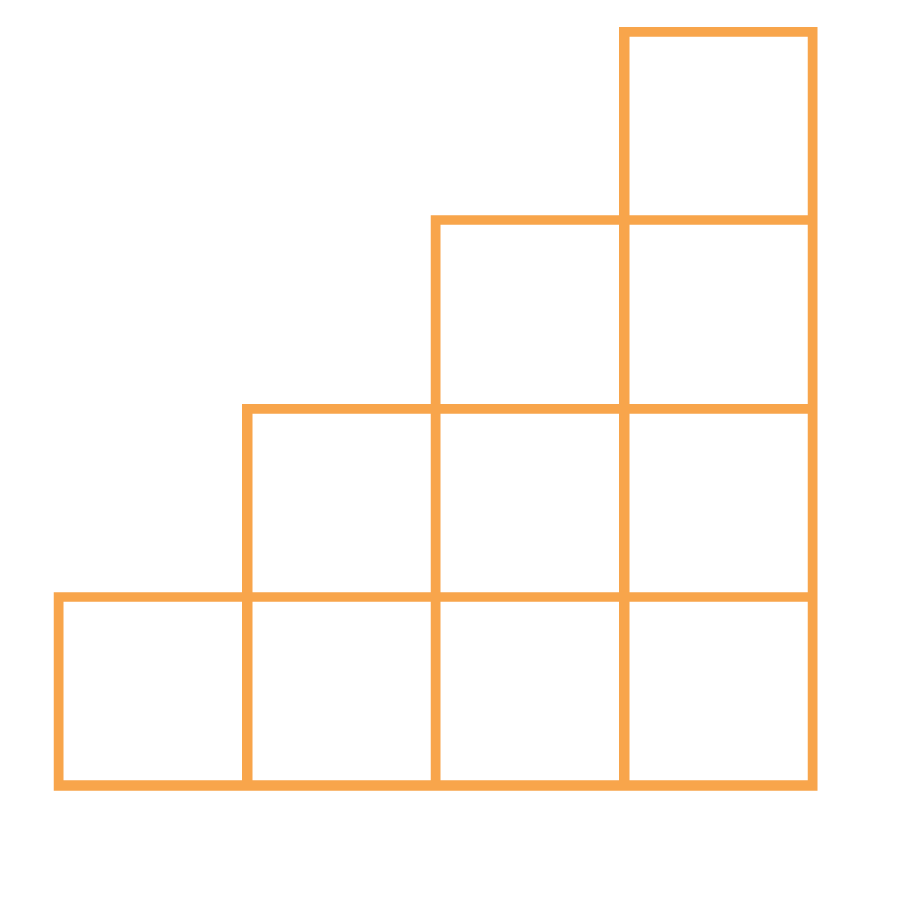
THANK YOU

